Slide 1
Chromatic Typewriter
Lane Snively && Quinton Hetland

Slide 2

Lane Snively
Quinton Hetland
Major: Computer Science
Major: Computer Science

Slide 3
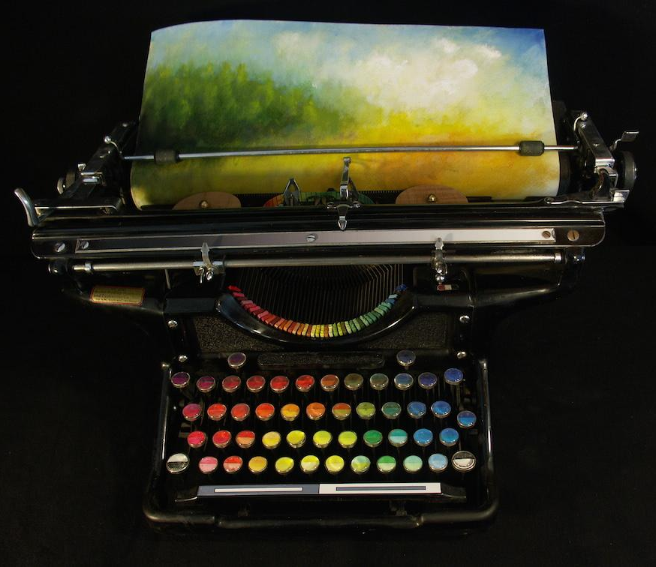
Problem and Solution
Couldn’t find software that simulates a real chromatic typewriter
We decided to create it

Slide 4
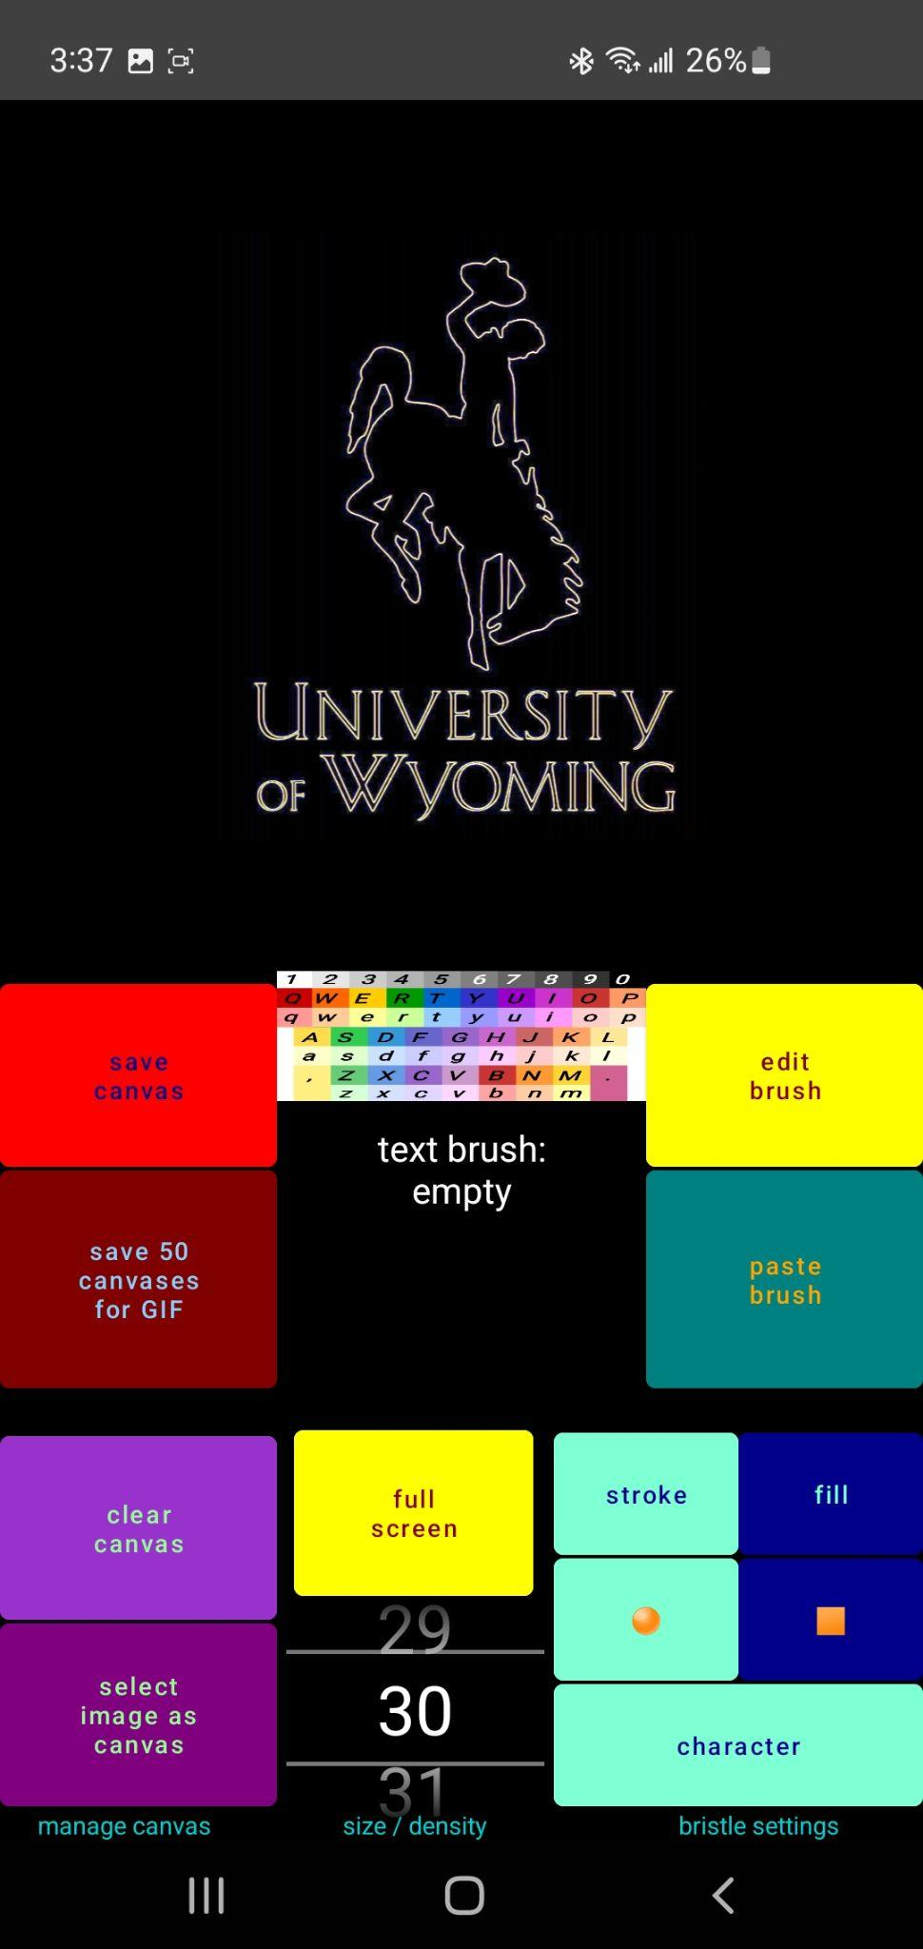
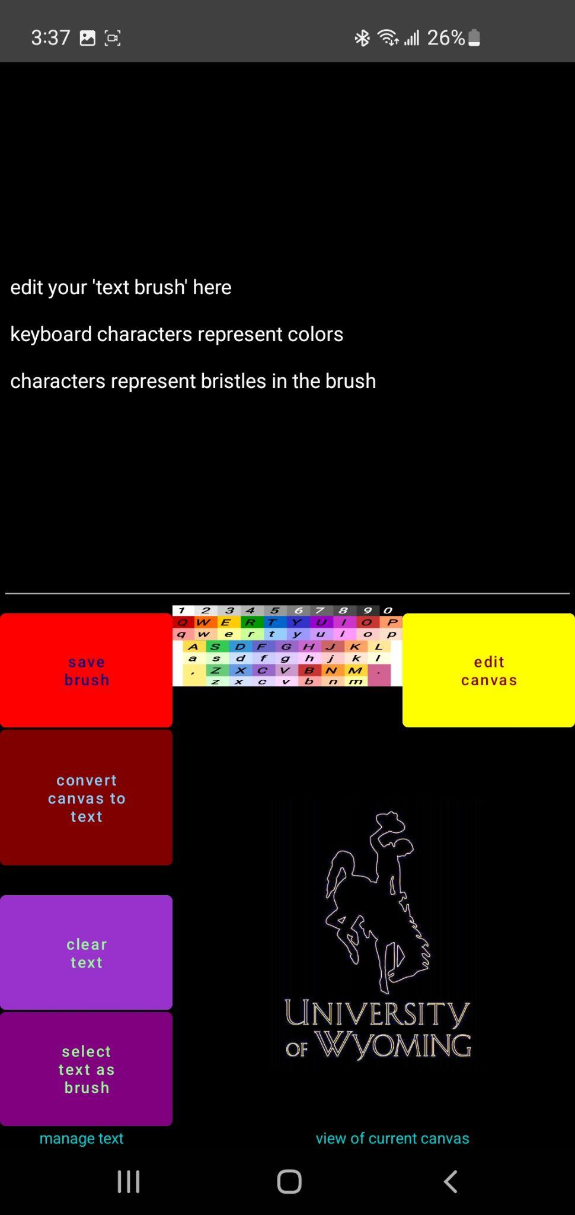
Chromatic Typewriter
User Interface
Edit ‘Text Brush’
Edit Canvas and Brush Settings

Slide 5
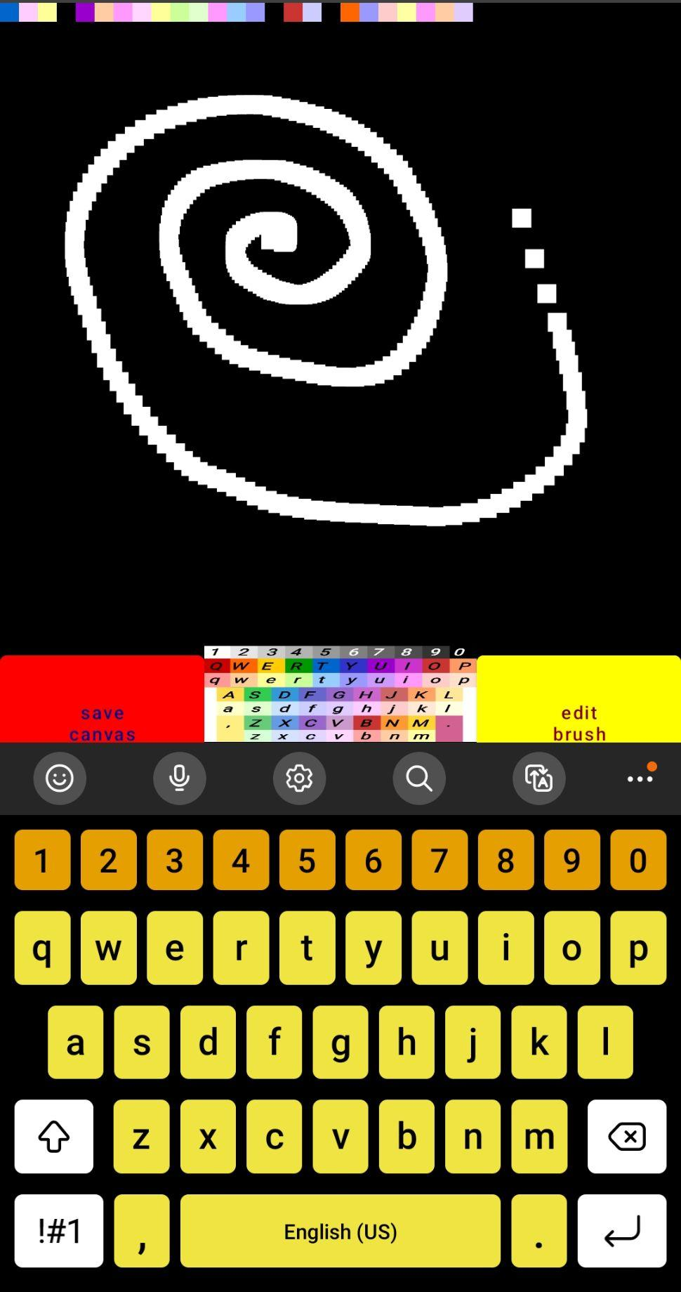
Edit Canvas using Stylus Pen or Your Finger
Edit Canvas using Keyboard

Slide 6
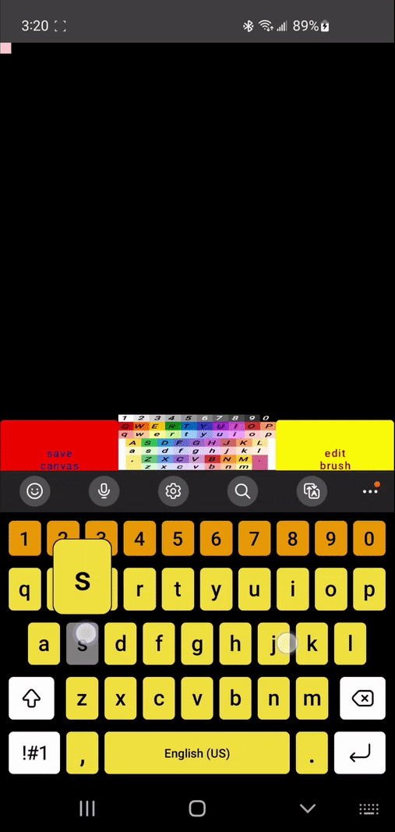
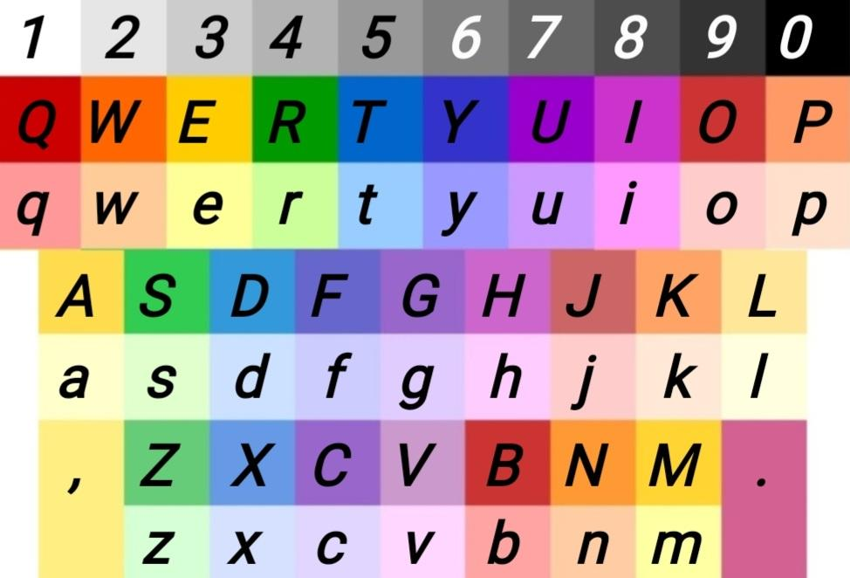

Slide 7
Feature:
‘Text Brush’ Stamping

Slide 8
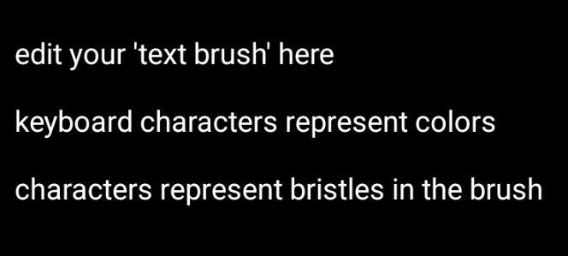

Slide 9

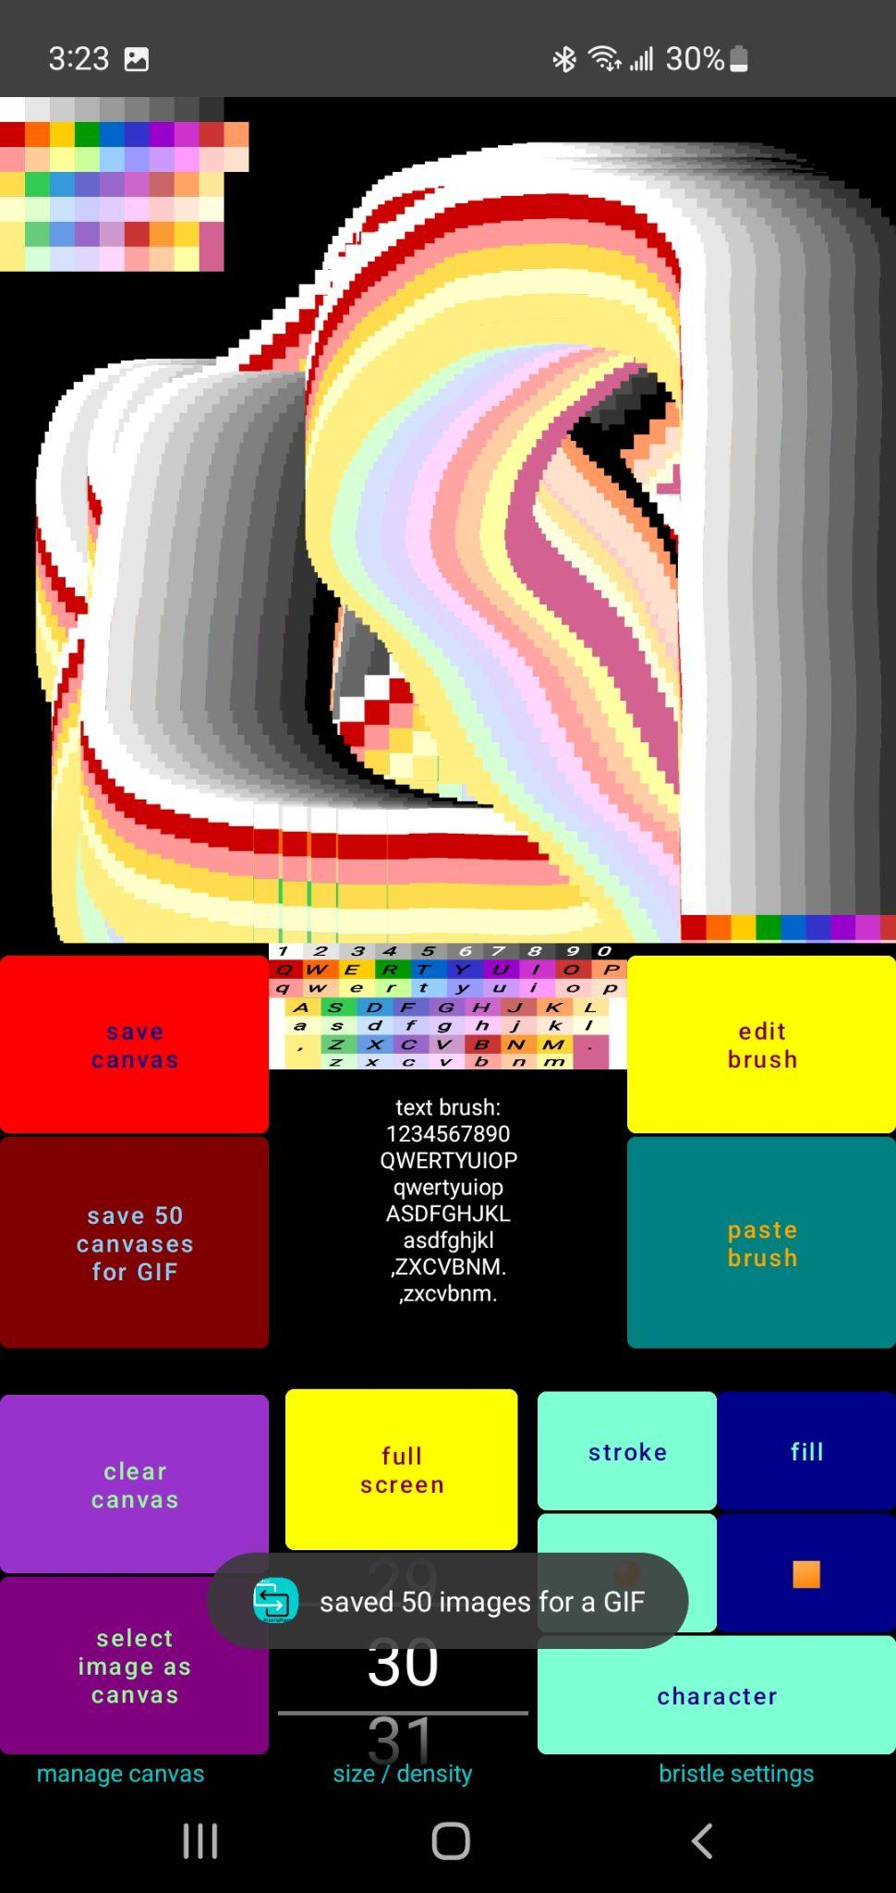
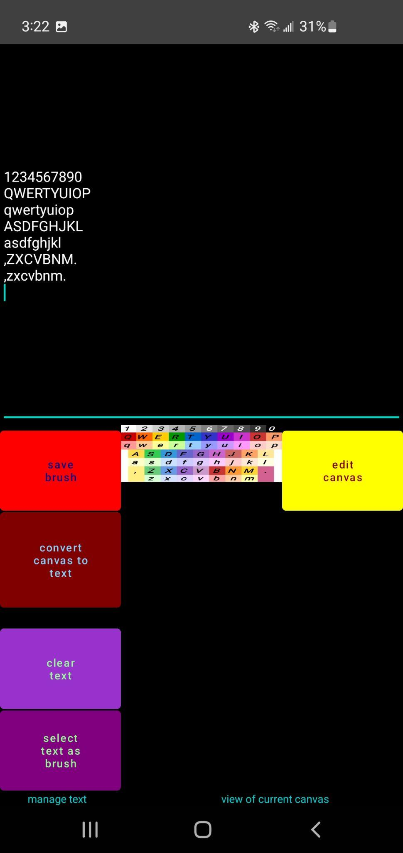
A Brush with
Each Character as a Filament

Slide 10
Bristle Settings:
Filament Shape and Size

Slide 11
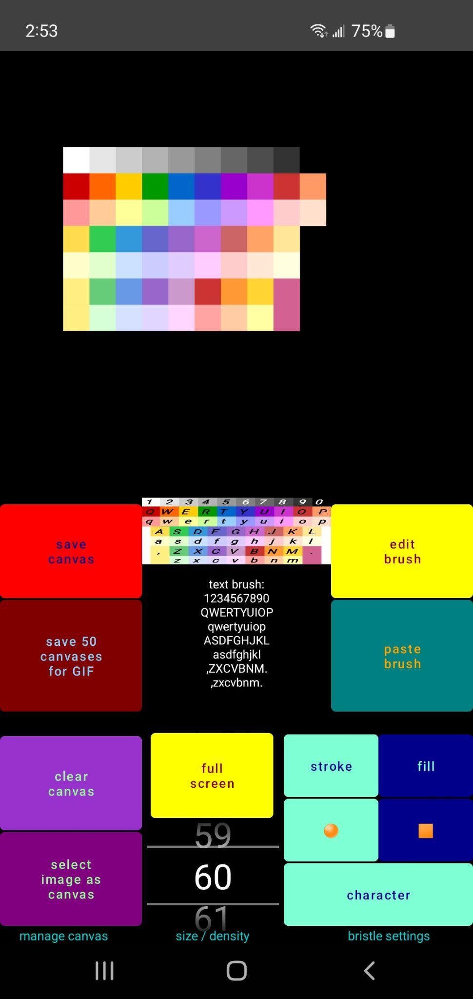
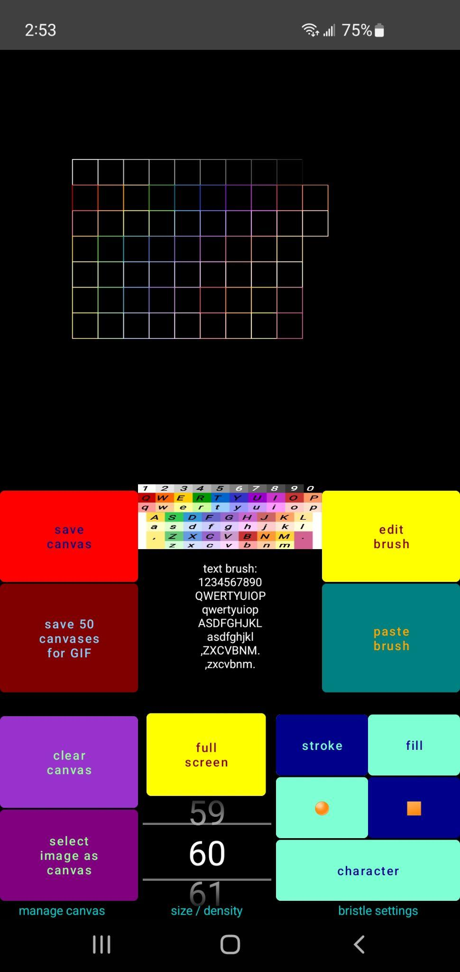

Slide 12
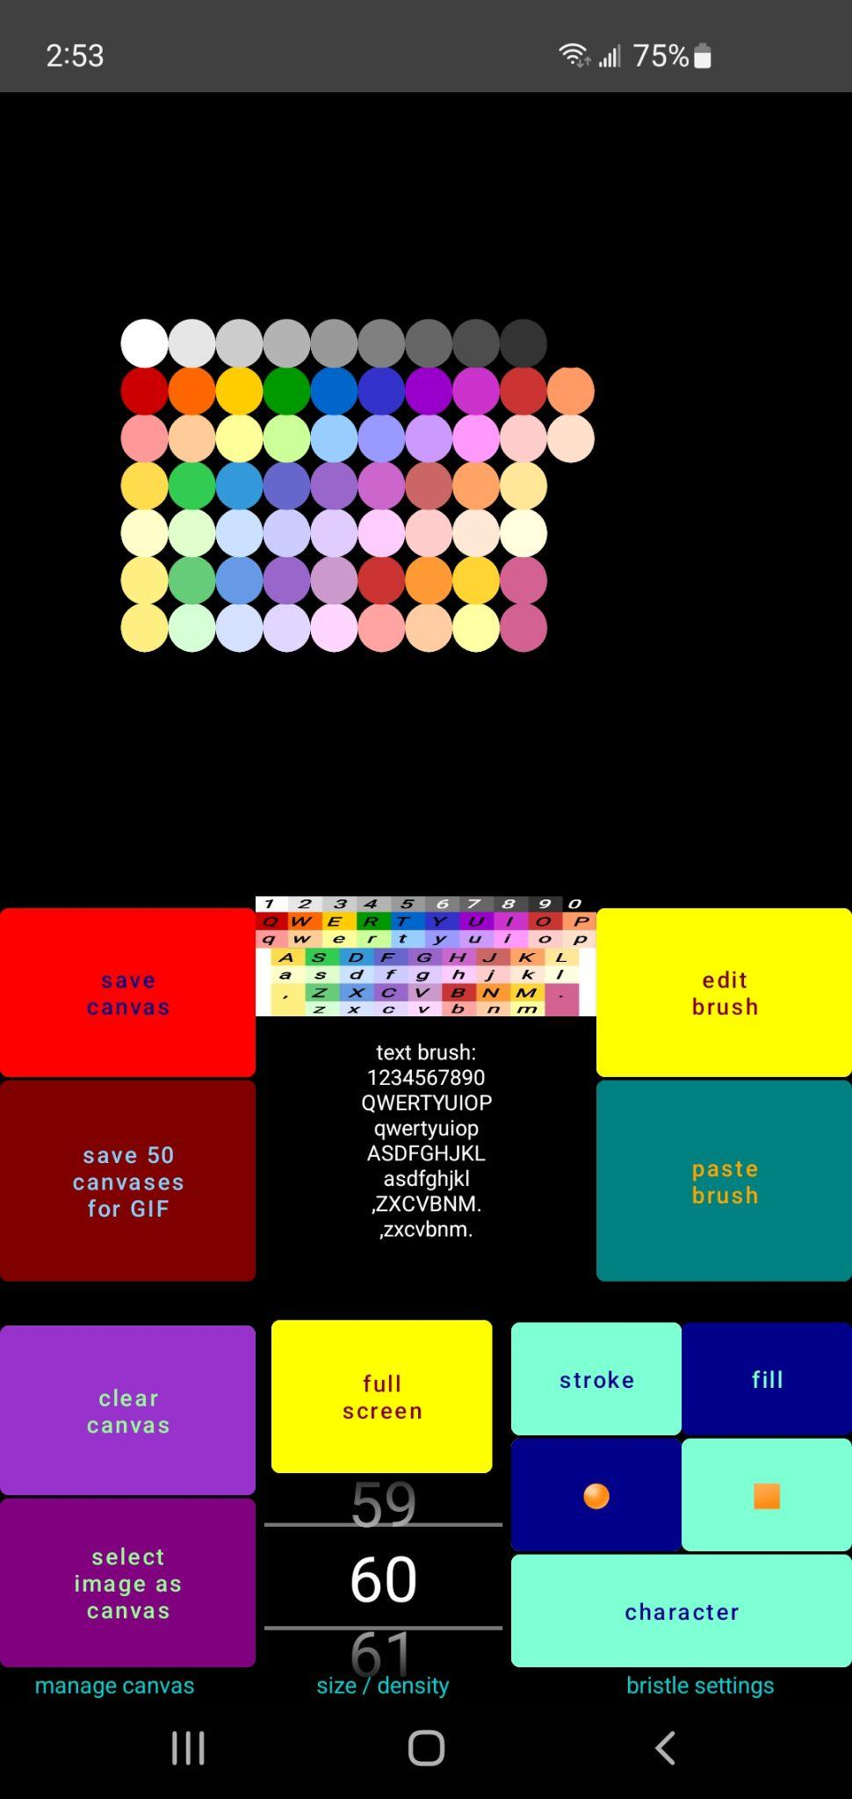
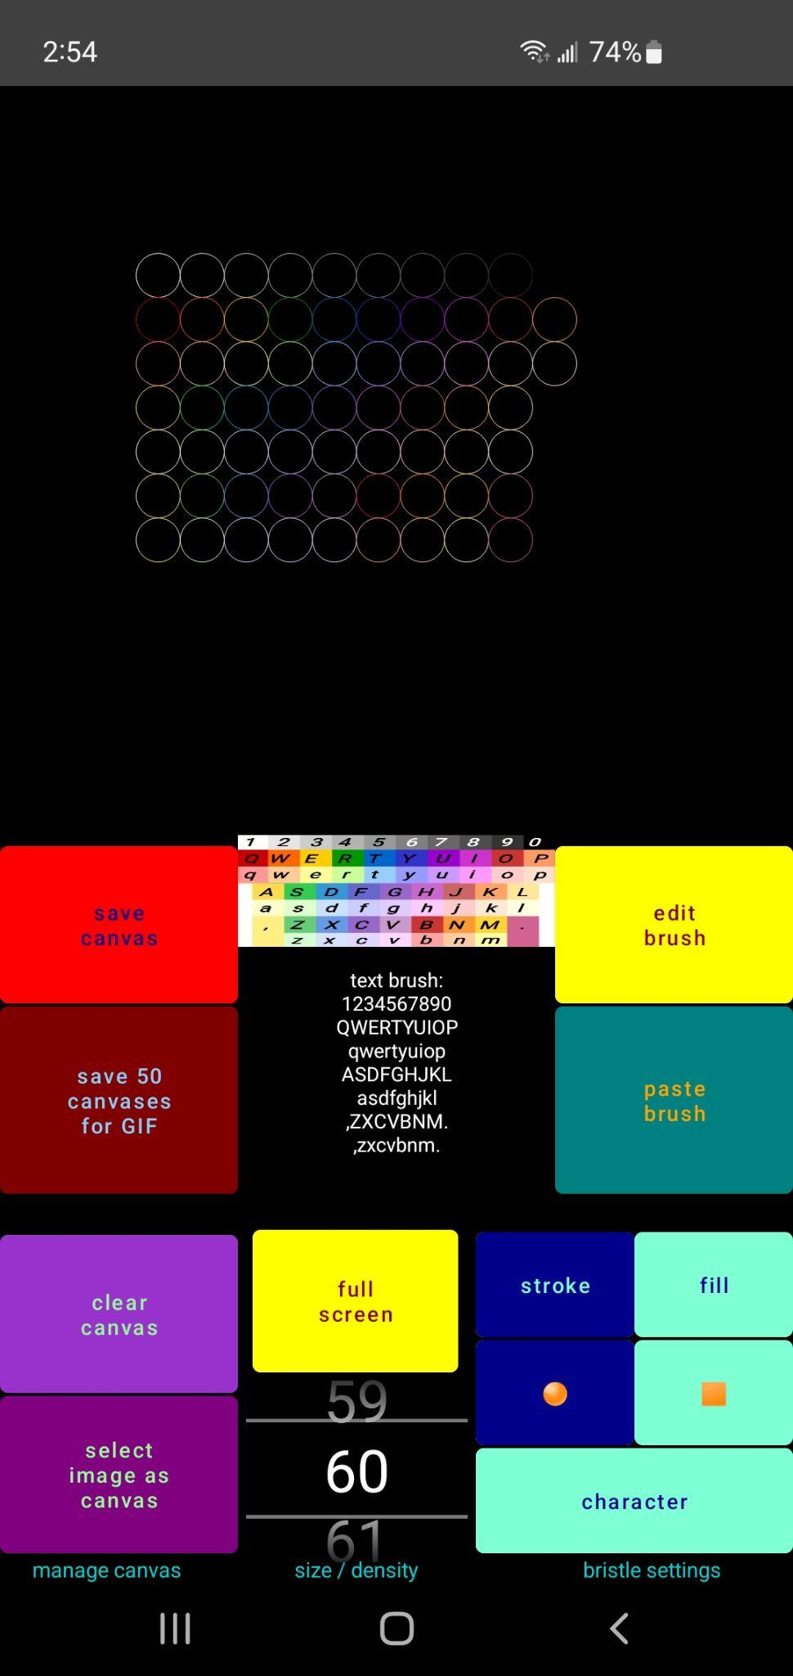

Slide 13
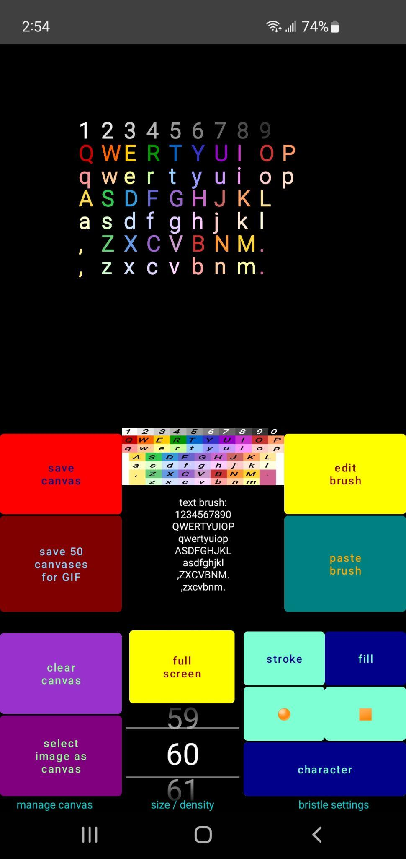
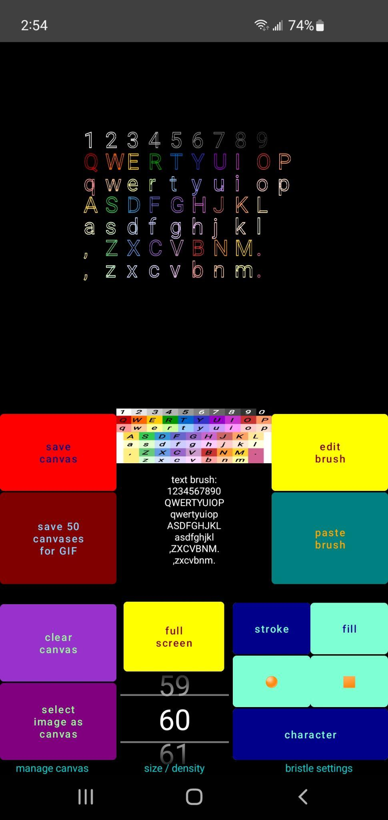

Slide 14
Feature:
Save 50 Images for GIF

Slide 15
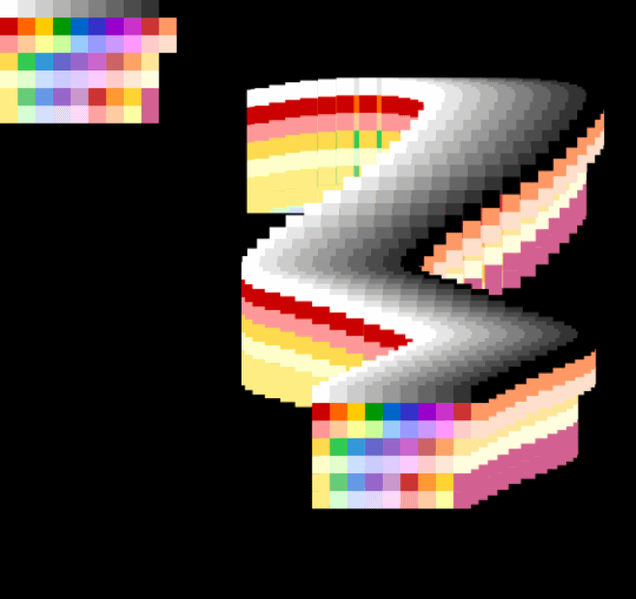
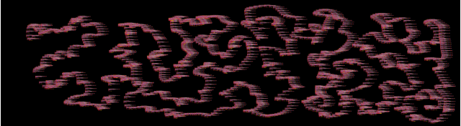
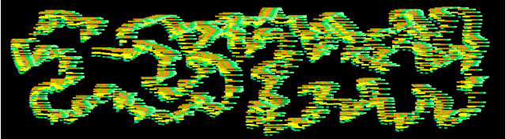

Slide 16
Feature:
Convert Image to Text Brush

Slide 17
Comparisons:
Original Photo and Pasted ‘Text Brush’

Slide 18
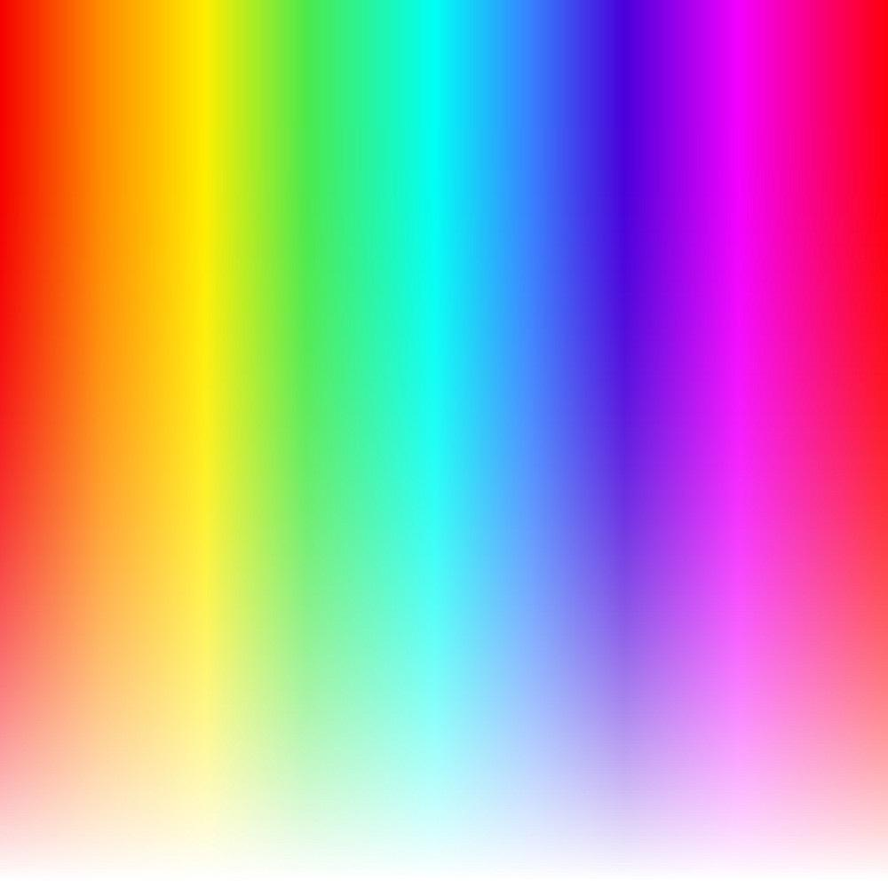
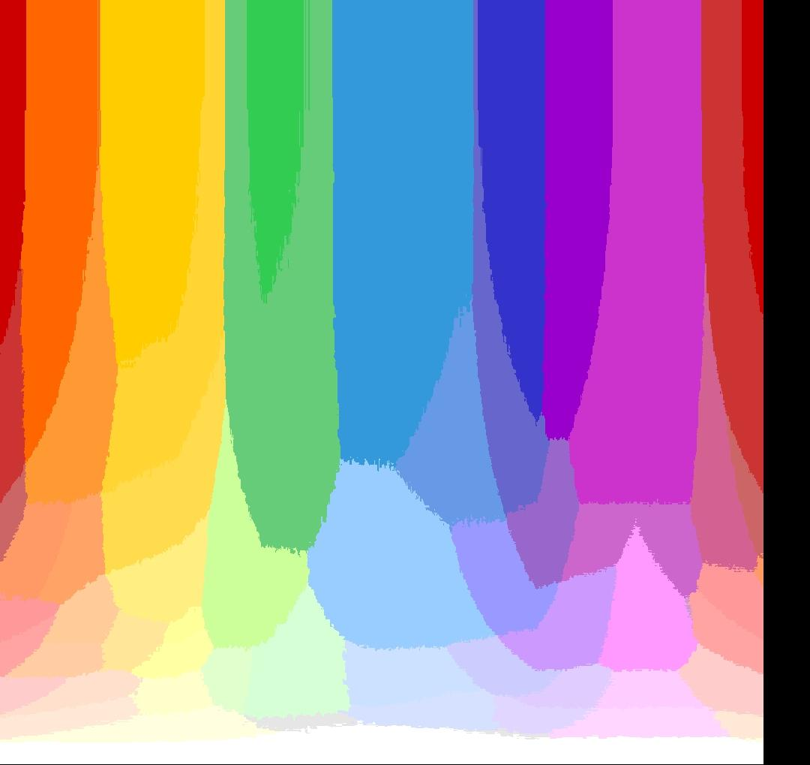
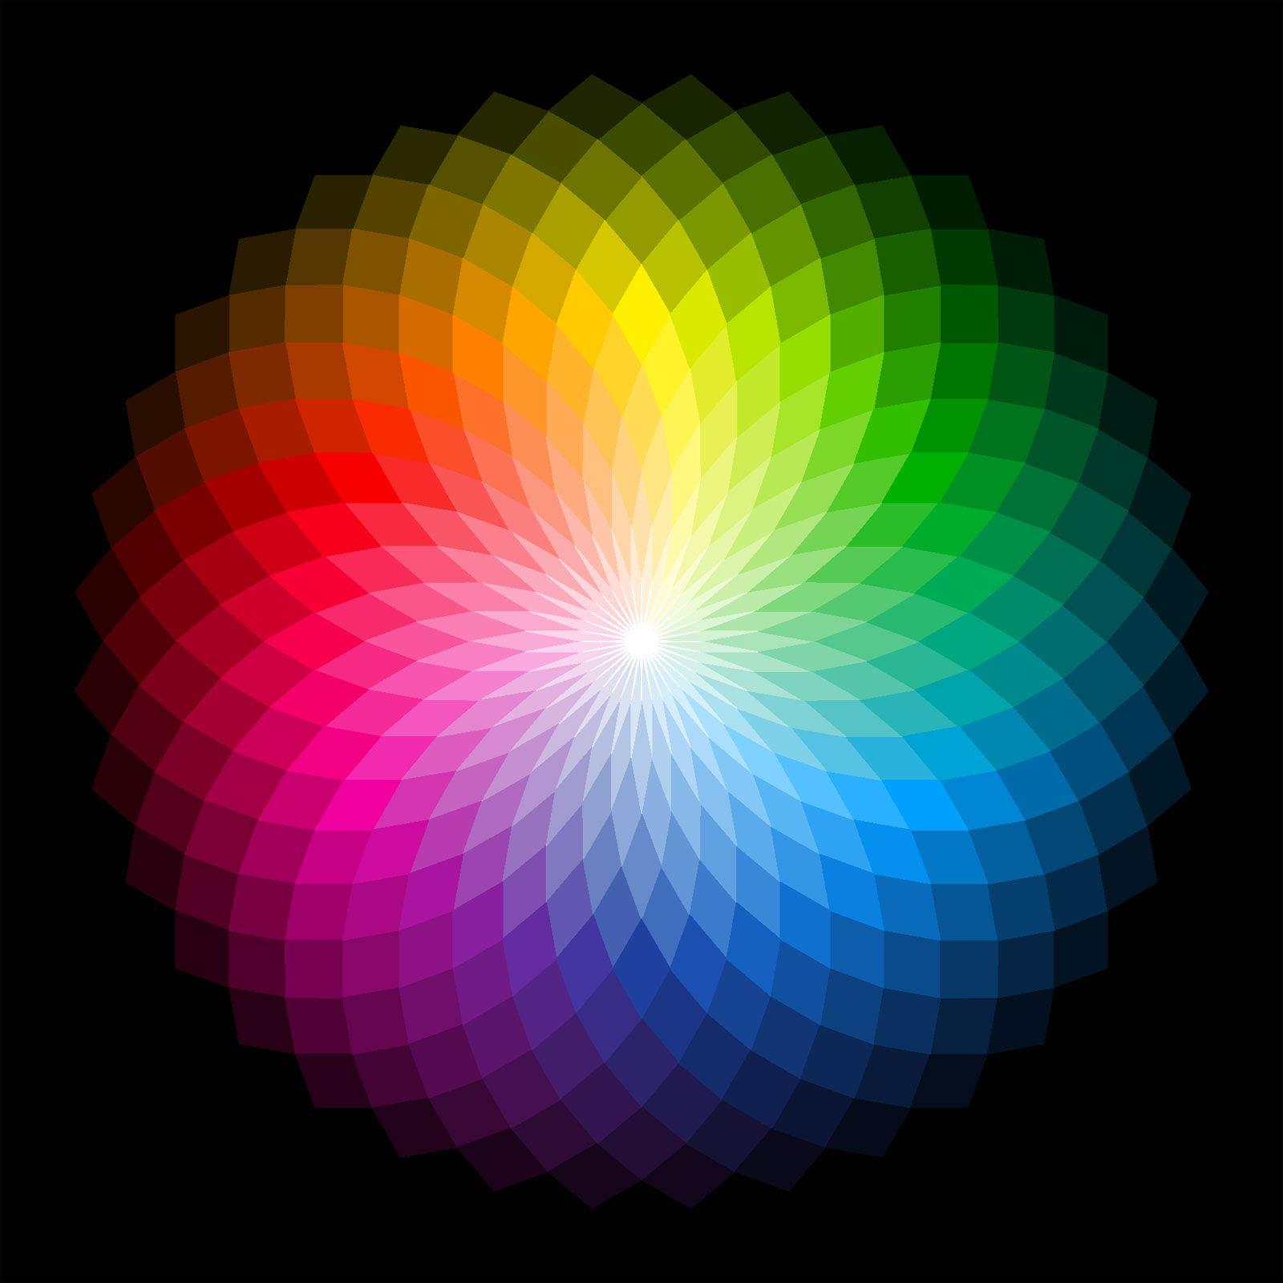
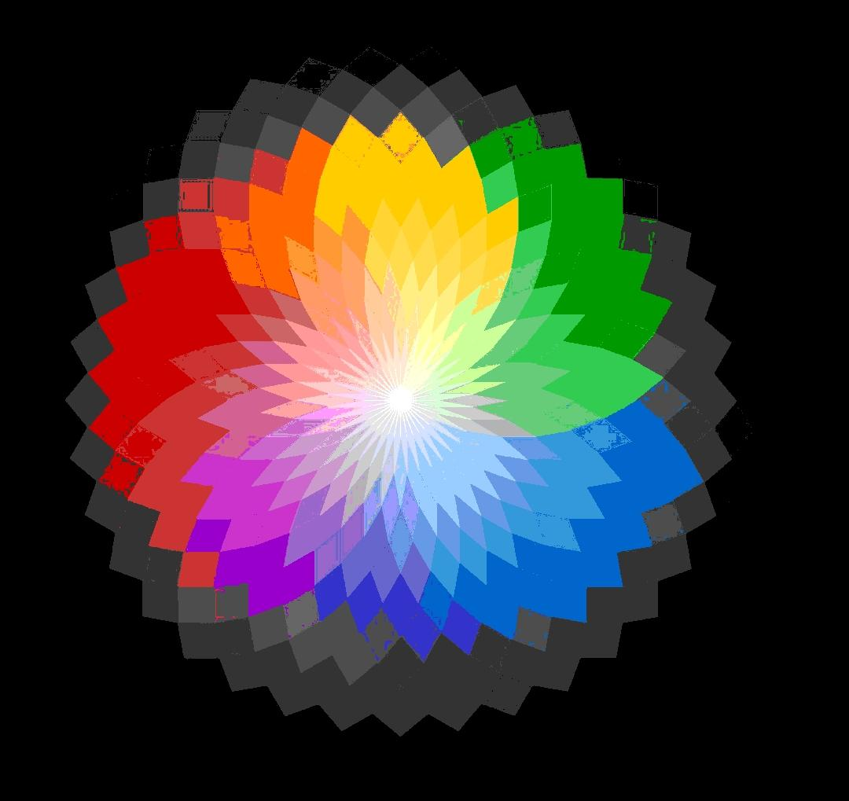
64 Colors Mapped to Keyboard Characters

Slide 19
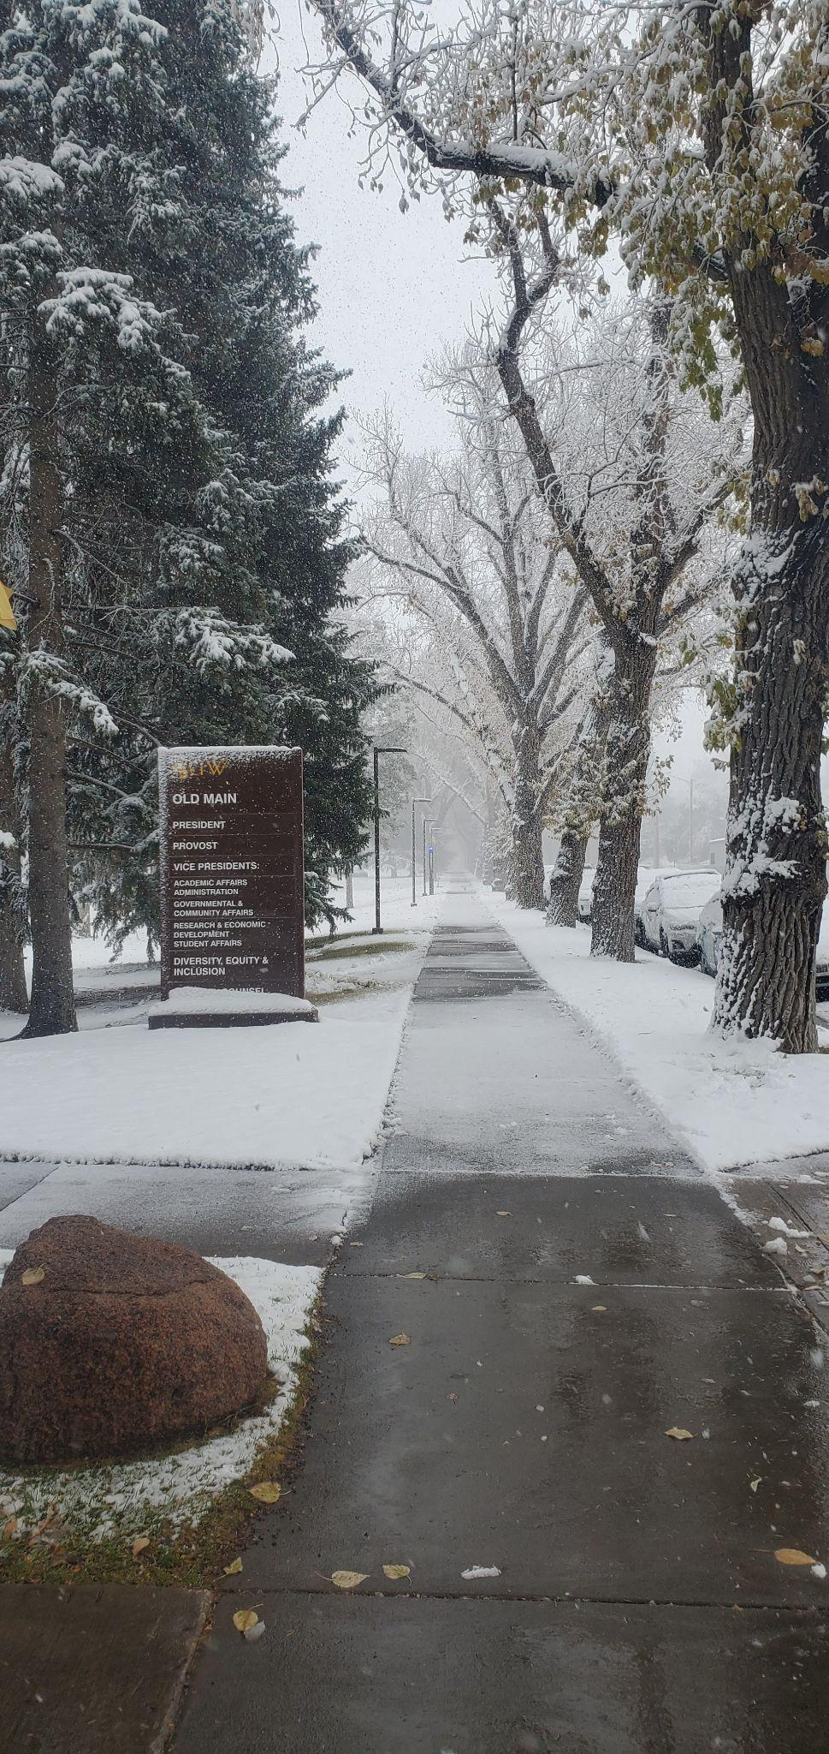
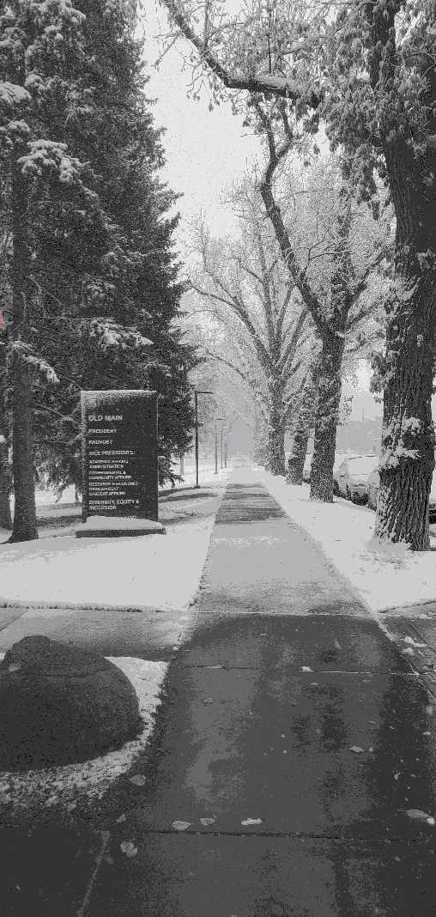

Slide 20
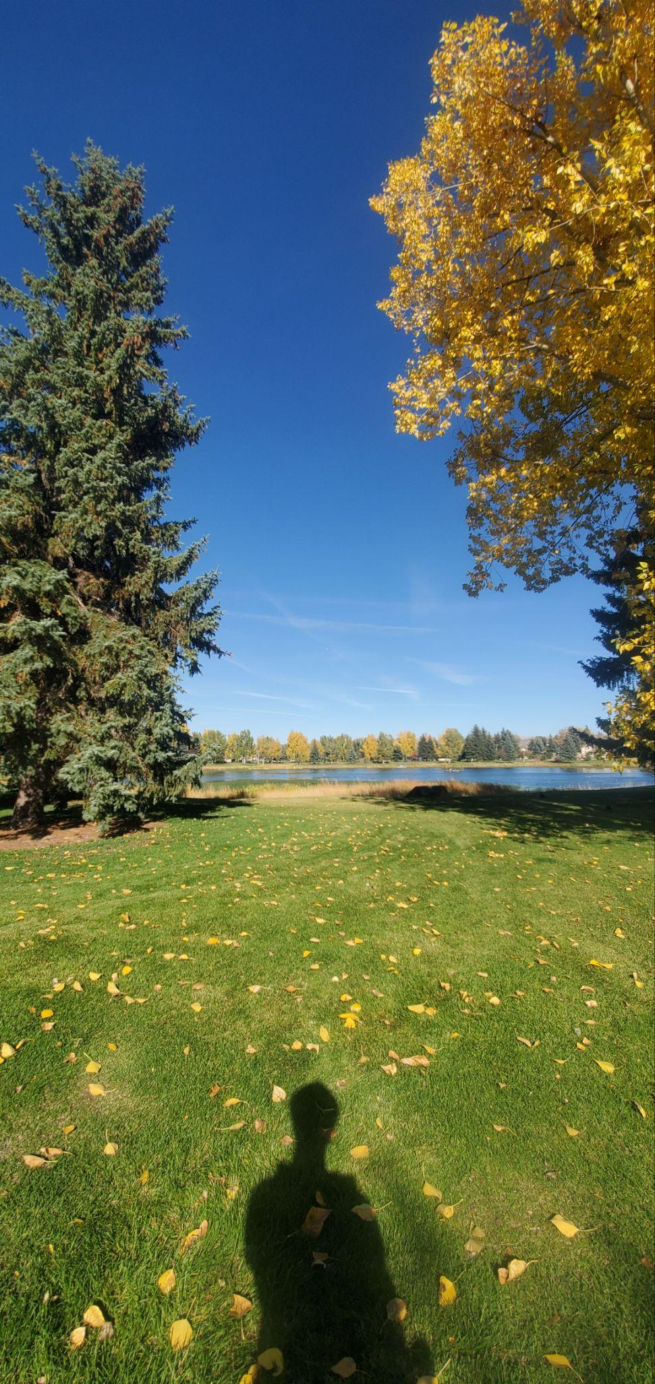
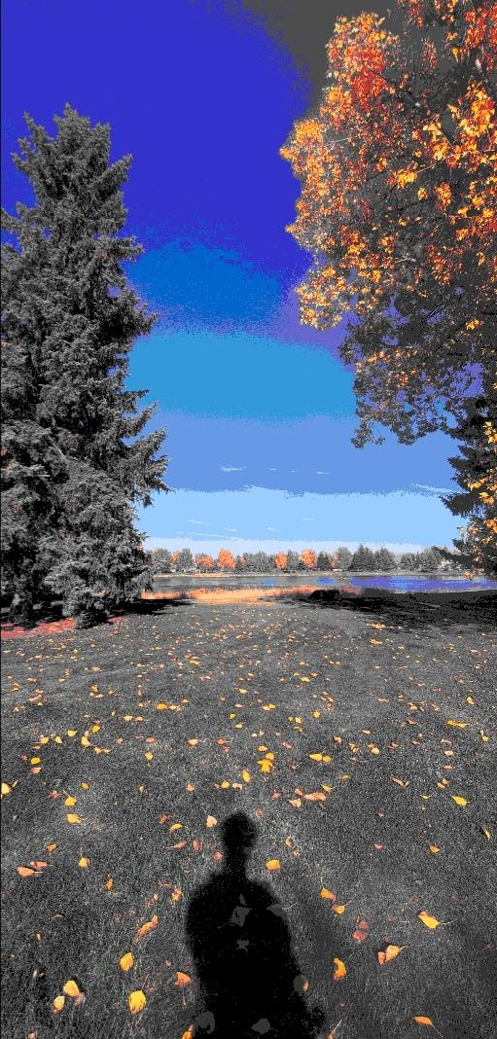

Slide 21
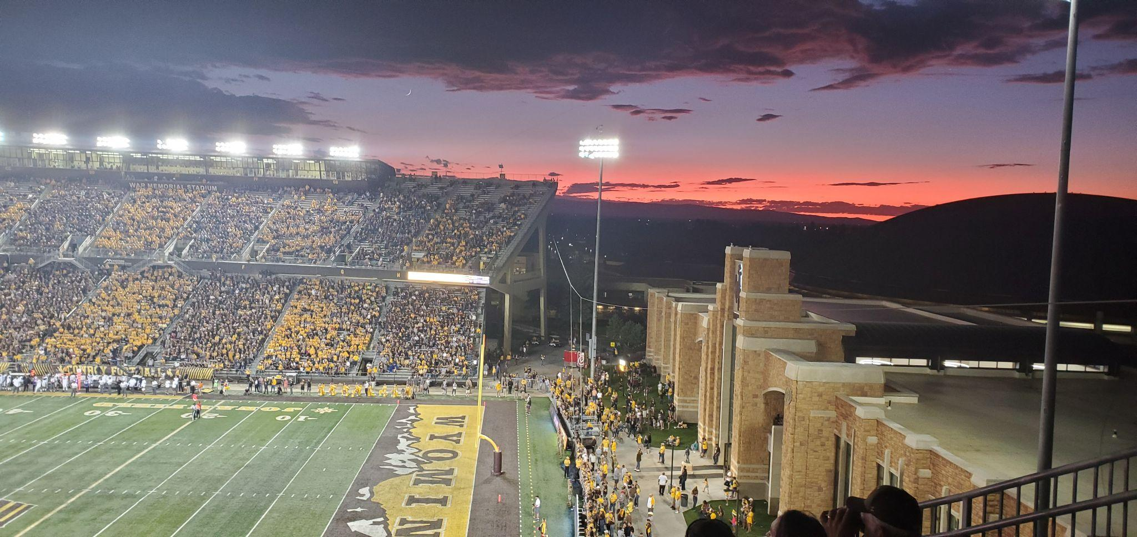
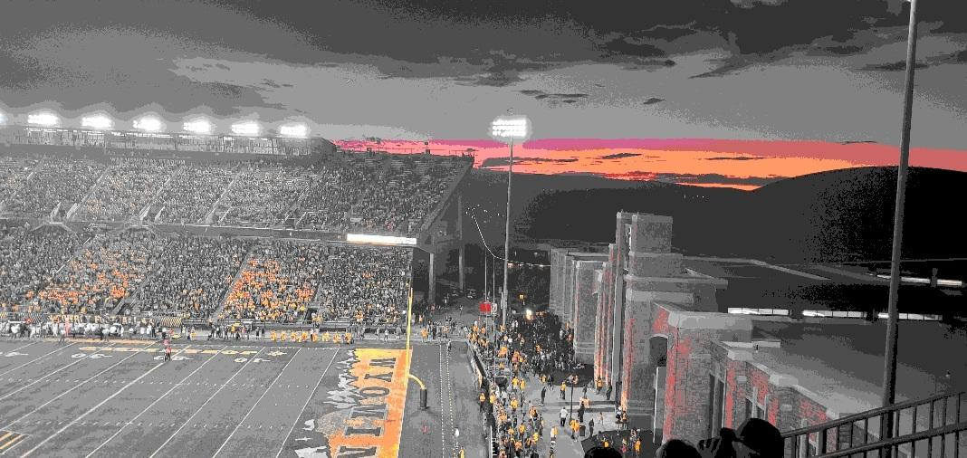

Slide 22

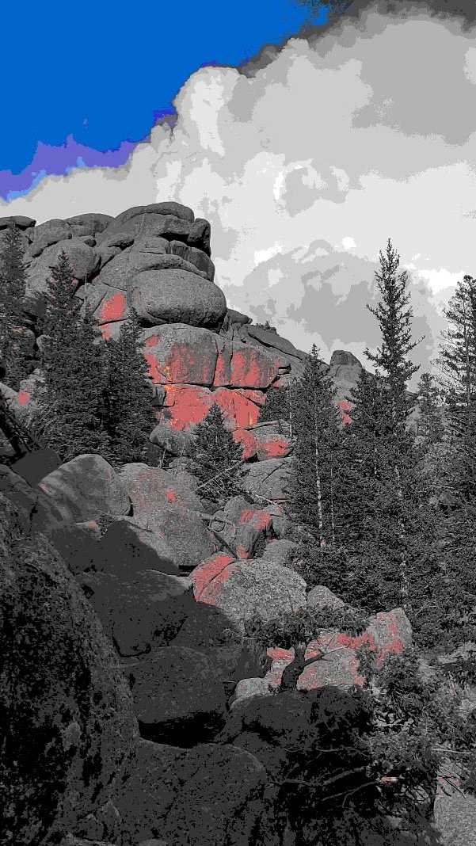

Slide 23
Conclusion
Chromatic Typewriter is an Android exclusive
Clone CT for iOS and publish to Apple Store
Remain unpaid, ad free
Open-source public GitHub repository

